Slide 1
Simply Confirm
Automating Audit Request Letters

Slide 2




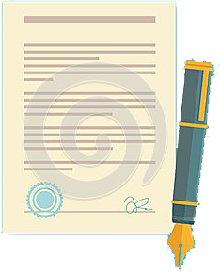

The Problem

Slide 3
Our Solution
Auditor
Chooses Customer
Puts in authorization requirements
Sends to customer
Customer
Reviews the request
Verifies authorization
Save

Slide 4
Bank
Receives request from auditor
Process the request
Send information back
Auditor
Receives information from bank
Extracts data
Completes Audit

